Slide 1
Dimension reduction
Ying shen
Sse, tongji university
Dec. 2016

Slide 2





K-Nearest Neighbor
KNN is a supervised learning algorithm
Given a test sample, find its closest $k$ neighbors in the training set. Predict its label by the majority class of its $k$ neighbors
Voting or average
Weighted voting or average
Lazy learning vs. eager learning
$k=1→$ ? is +
$$P_{KNN}\left(err\right)≤2×(1−P(c^{∗}|x))$$
$k=3→$ ? is -
+
-
$k=5→$ ? is +
+
?
test sample
-
+

Slide 3
Raw data can be complex, high-dimensional
To understand a phenomenon we measure various related quantities
If we knew what to measure or how to represent our measurements we might find simple relationships
But in practice we often measure redundant signals, e.g., US and European shoe sizes
We also represent data via the method by which it was gathered, e.g., pixel representation of brain imaging data

Slide 4
Dimensionality reduction
Issues
Measure redundant signals
Represent data via the method by which it was gathered
Goal: Find a ‘better’ representation for data
To visualize and discover hidden patterns
Preprocessing for supervised task
How do we define ‘better’?

Slide 5
E.g., Shoe size
We take noisy measurements on European and American scale
How can we do ‘better’, i.e., find a simpler, compact representation?
Pick a direction and project onto this direction
European Size
American Size

Slide 6
E.g., Shoe size
We take noisy measurements on European and American scale
How can we do ‘better’, i.e., find a simpler, compact representation?
Pick a direction and project onto this direction
European Size
American Size

Slide 7
Goal: Minimize reconstruction error
Minimize Euclidean distances between original points and their projections
PCA solution solves this problem!
PCA — reconstruct 2D data via 2D data with single degree of freedom. Evaluate reconstructions (represented by blue line) by Euclidean distances
European Size
American Size

Slide 8
Another goal: Maximize variance
To identify patterns we want to study variation across observations
Can we do ‘better’, i.e., find a compact representation that captures variation?
European Size
American Size

Slide 9
Another goal: Maximize variance
To identify patterns we want to study variation across observations
Can we do ‘better’, i.e., find a compact representation that captures variation?
PCA solution finds directions of maximal variance!
European Size
American Size

Slide 10


Principal Component Analysis (PCA)
Identify the orientation with largest variance
Suppose X contains n data points, and each data point is p-dimensional, that is
$X=\left\{x_{1},x_{2},…,x_{n}\right\}, x_{i}∈ℝ^{p×1},X∈ℝ^{p×n}$
Now, we want to find such a unit vector $α_{1}$,
$$α_{1}=\arg{\max_{α}{ var(α^{T}X)}, α∈ℝ^{p×1}}$$

Slide 11
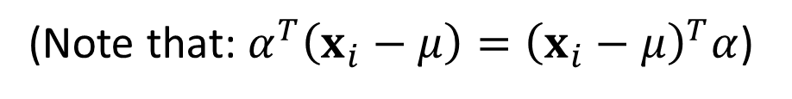
Principal Component Analysis (PCA)
Identify the orientation with largest variance
(Note that: $α^{T}\left(x_{i}−μ\right)={\left(x_{i}−μ\right)}^{T}α$)
where
and is the covariance matrix

Slide 12

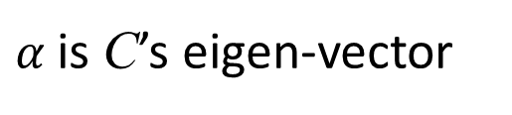
Principal Component Analysis (PCA)
Identify the orientation with largest variance
Since $α$ is unit, $α^{T}α=1$
Based on Lagrange multiplier method, we need to,
Since,
$α$is C’s eigen-vector

Slide 13
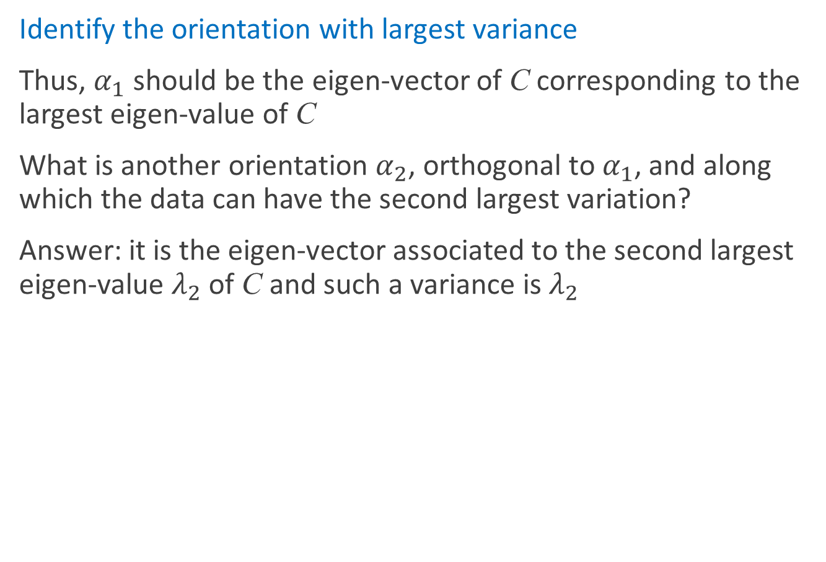
Principal Component Analysis (PCA)
Identify the orientation with largest variance
Thus, $α_{1}$ should be the eigen-vector of C corresponding to the largest eigen-value of C
What is another orientation $α_{2}$, orthogonal to $α_{1}$, and along which the data can have the second largest variation?
Answer: it is the eigen-vector associated to the second largest eigen-value $λ_{2}$ of C and such a variance is $λ_{2}$

Slide 14
Principal Component Analysis (PCA)
Identify the orientation with largest variance
Results: the eigen-vectors of C forms a set of orthogonal basis and they are referred as Principal Components of the original data X
You can consider PCs as a set of orthogonal coordinates. Under such a coordinate system, variables are not correlated.

Slide 15
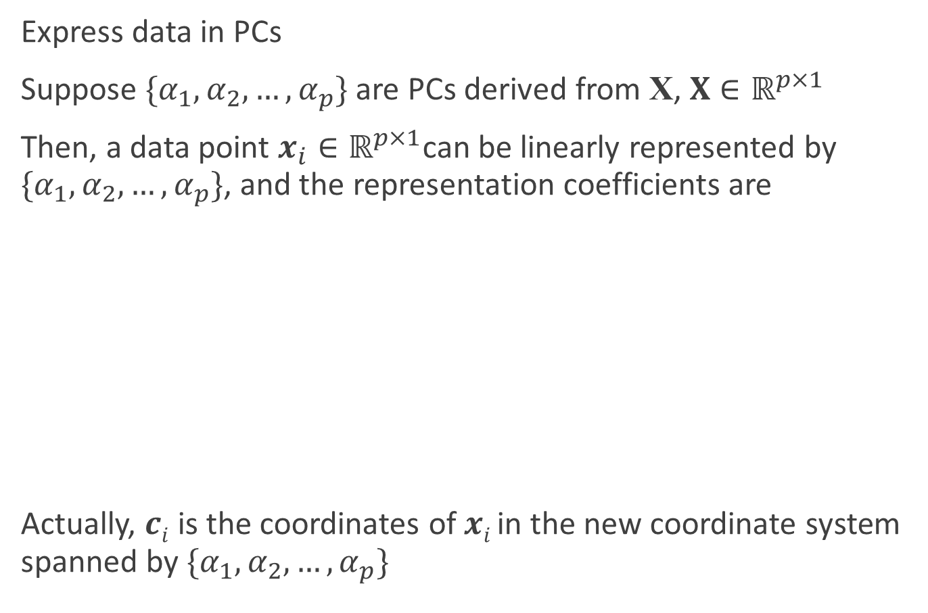
Principal Component Analysis (PCA)
Express data in PCs
Suppose $\{α_{1},α_{2},…,α_{p}\}$ are PCs derived from X, $X∈ℝ^{p×1}$
Then, a data point $x_{i}∈ℝ^{p×1}$can be linearly represented by $\{α_{1},α_{2},…,α_{p}\}$, and the representation coefficients are
Actually, $ci$ is the coordinates of $xi$ in the new coordinate system spanned by $\{α_{1},α_{2},…,α_{p}\}$

Slide 16

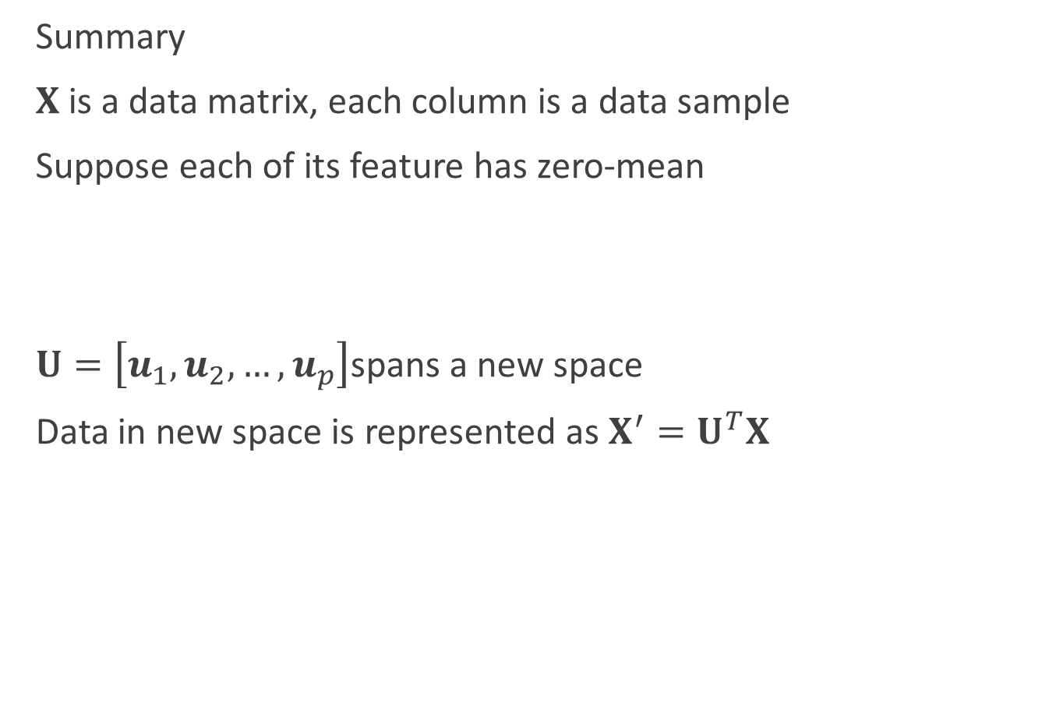
Principal Component Analysis (PCA)
Summary
$X$is a data matrix, each column is a data sample
Suppose each of its feature has zero-mean
$U=\left[u_{1},u_{2},…,u_{p}\right]$spans a new space
Data in new space is represented as $X^{′}=U^{T}X$
In new space, dimensions of data are not correlated

Slide 17
Principal Component Analysis (PCA)
Illustration
x , y
(2.5, 2.4) (0.5, 0.7)
(2.2, 2.9)
(1.9, 2.2)
(3.1, 3.0)
(2.3, 2.7)
(2.0, 1.6)
(1.0, 1.1)
(1.5, 1.6)
(1.1, 0.9)
Eigen-values =
Corresponding eigen-vectors:

Slide 18
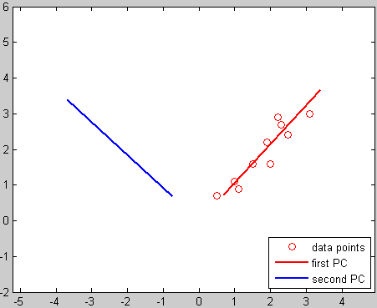
Principal Component Analysis (PCA)
Illustration

Slide 19
Principal Component Analysis (PCA)
Illustration
Coordinates of the data points in the new coordinate system

Slide 20
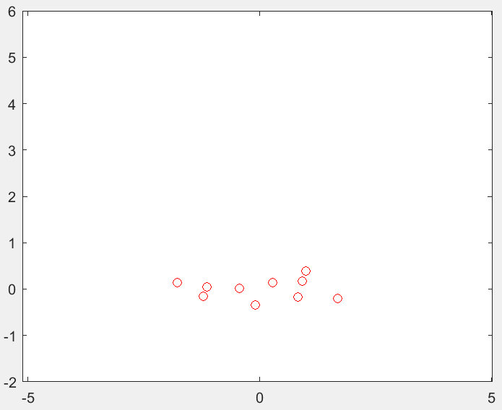
Principal Component Analysis (PCA)
Illustration
Coordinates of the data points in the new coordinate system
Draw newC on the plot
In such a new system, two variables are linearly independent!

Slide 21
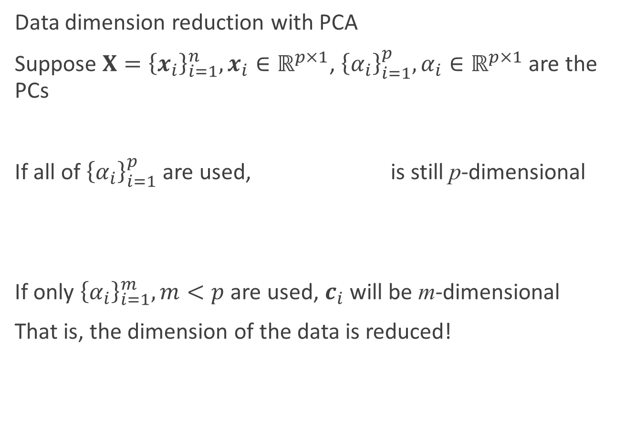
Principal Component Analysis (PCA)
Data dimension reduction with PCA
Suppose $X={\left\{x_{i}\right\}}_{i=1}^{n}, x_{i}∈ℝ^{p×1}$, ${\left\{α_{i}\right\}}_{i=1}^{p},α_{i}∈ℝ^{p×1}$ are the PCs
If all of ${\left\{α_{i}\right\}}_{i=1}^{p}$ are used, is still p-dimensional
If only ${\left\{α_{i}\right\}}_{i=1}^{m}, m<p$ are used, $c_{i}$ will be m-dimensional
That is, the dimension of the data is reduced!

Slide 22
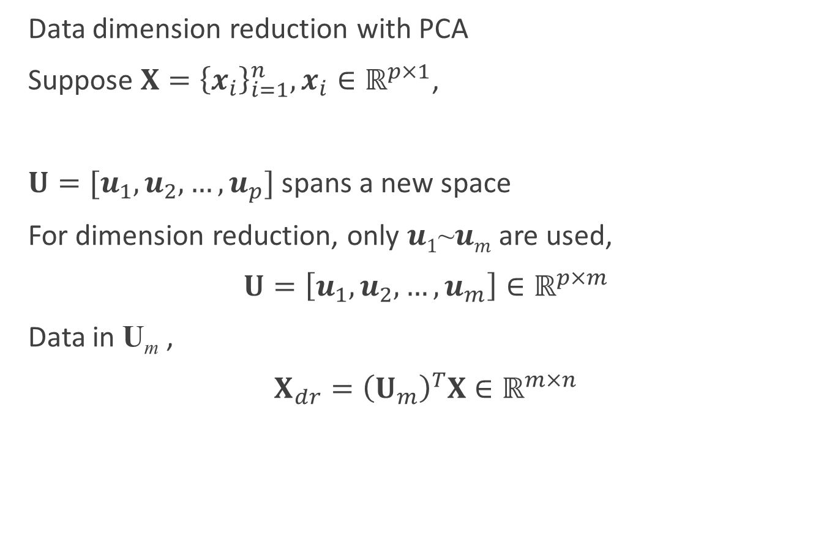
Principal Component Analysis (PCA)
Data dimension reduction with PCA
Suppose $X={\left\{x_{i}\right\}}_{i=1}^{n}, x_{i}∈ℝ^{p×1}$,
$U=[u_{1},u_{2},…,u_{p}]$ spans a new space
For dimension reduction, only $u1$~$um$ are used,
$U=\left[u_{1},u_{2},…,u_{m}\right]∈ℝ^{p×m}$
Data in U_{m} ,
$X_{dr}={\left(U_{m}\right)}^{T}X∈ℝ^{m×n}$

Slide 23
Principal Component Analysis (PCA)
Illustration
Coordinates of the data points in the new coordinate system
If only the first PC (corresponds to the largest eigen-value) is remained

Slide 24
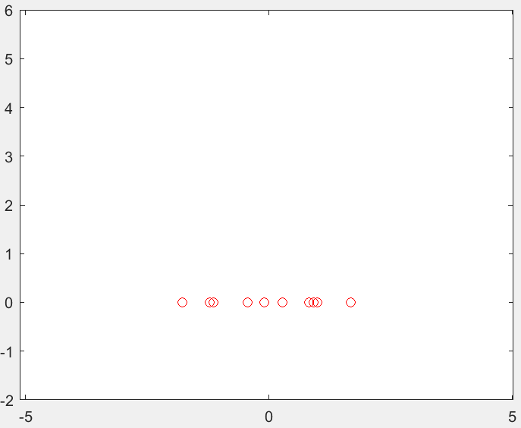
Principal Component Analysis (PCA)
Illustration
All PCs are used
Only 1 PC is used
Dimension reduction!

Slide 25
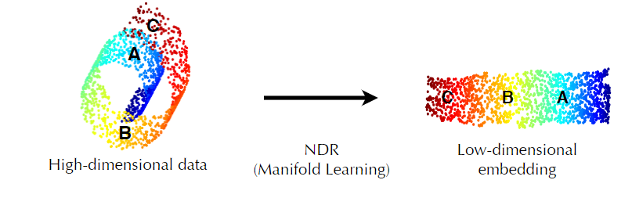
Low-dimensional embedding
High dimension results in sparse distribution of samples
Curse of dimensionality and dimension reduction
Low-dimensional embedding

Slide 26
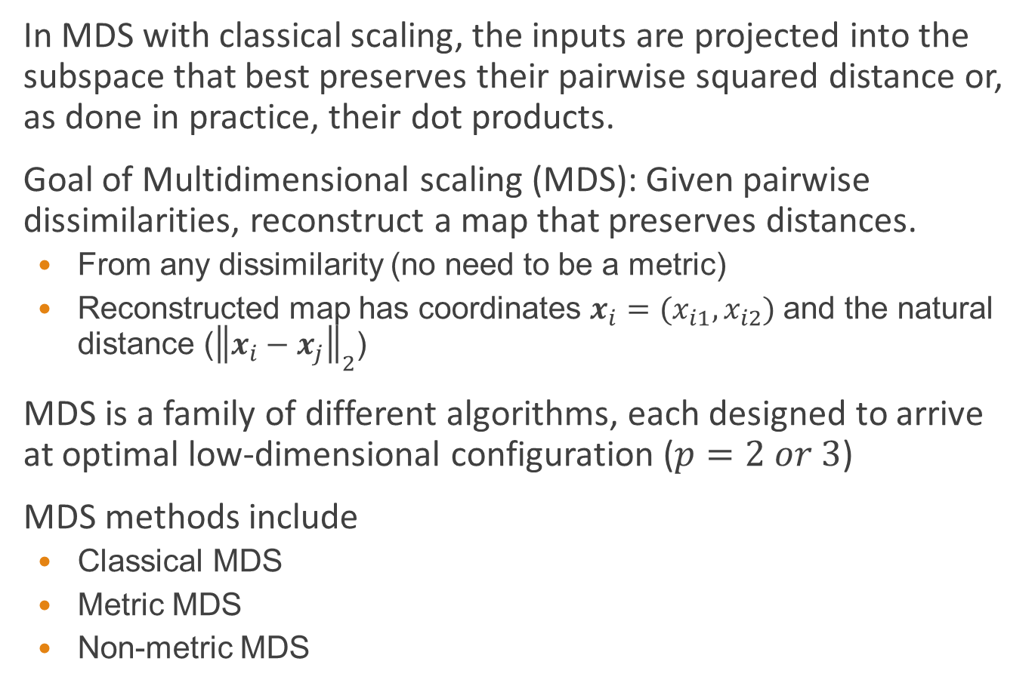
Multiple Dimensional Scaling (MDS)
In MDS with classical scaling, the inputs are projected into the subspace that best preserves their pairwise squared distance or, as done in practice, their dot products.
Goal of Multidimensional scaling (MDS): Given pairwise dissimilarities, reconstruct a map that preserves distances.
From any dissimilarity (no need to be a metric)
Reconstructed map has coordinates $x_{i}=(x_{i1}, x_{i2})$ and the natural distance (${\left\|x_{i}−x_{j}\right\|}_{2}$)
MDS is a family of different algorithms, each designed to arrive at optimal low-dimensional configuration ($p=2 or 3$)
MDS methods include
Classical MDS
Metric MDS
Non-metric MDS

Slide 27
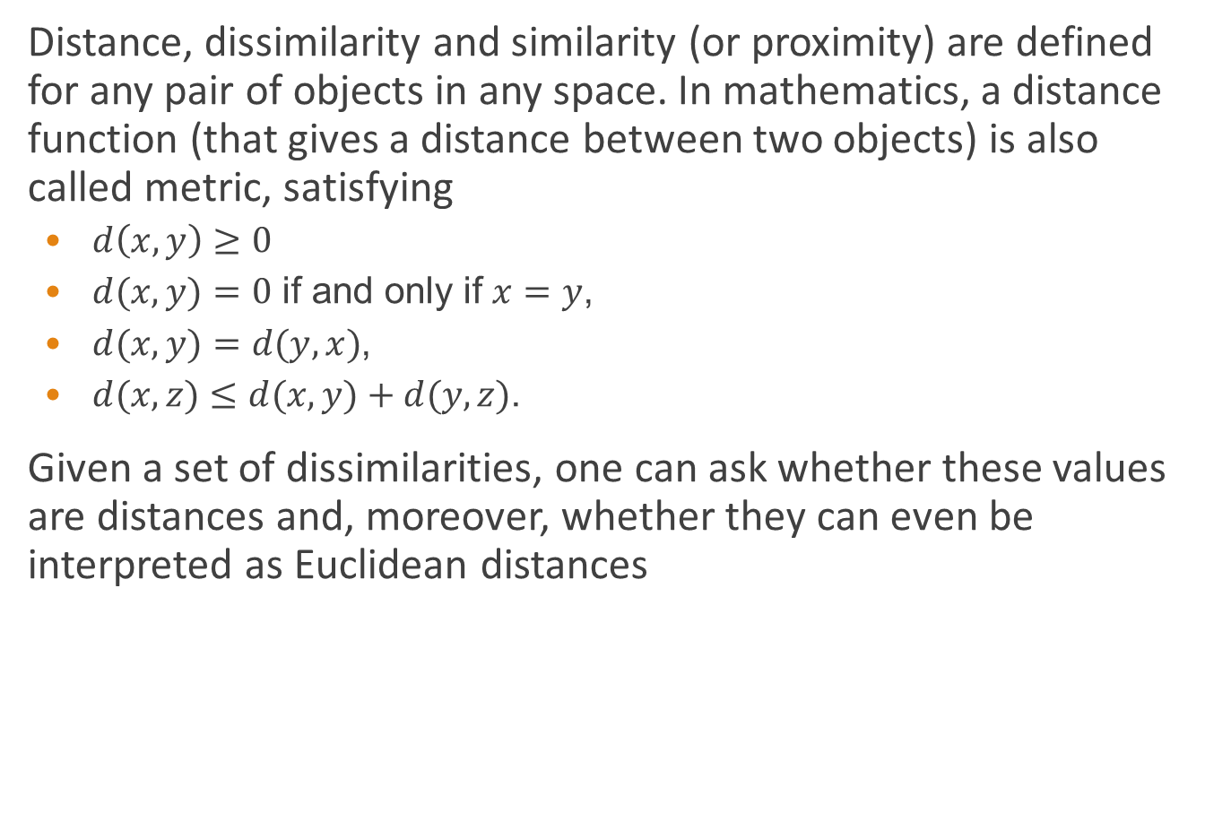
Distance, dissimilarity and similarity
Distance, dissimilarity and similarity (or proximity) are defined for any pair of objects in any space. In mathematics, a distance function (that gives a distance between two objects) is also called metric, satisfying
$d\left(x, y\right)≥0$
$d(x, y)=0$ if and only if $x=y$,
$d(x, y)=d(y, x)$,
$d(x, z)≤d(x, y)+d(y, z)$.
Given a set of dissimilarities, one can ask whether these values are distances and, moreover, whether they can even be interpreted as Euclidean distances

Slide 28
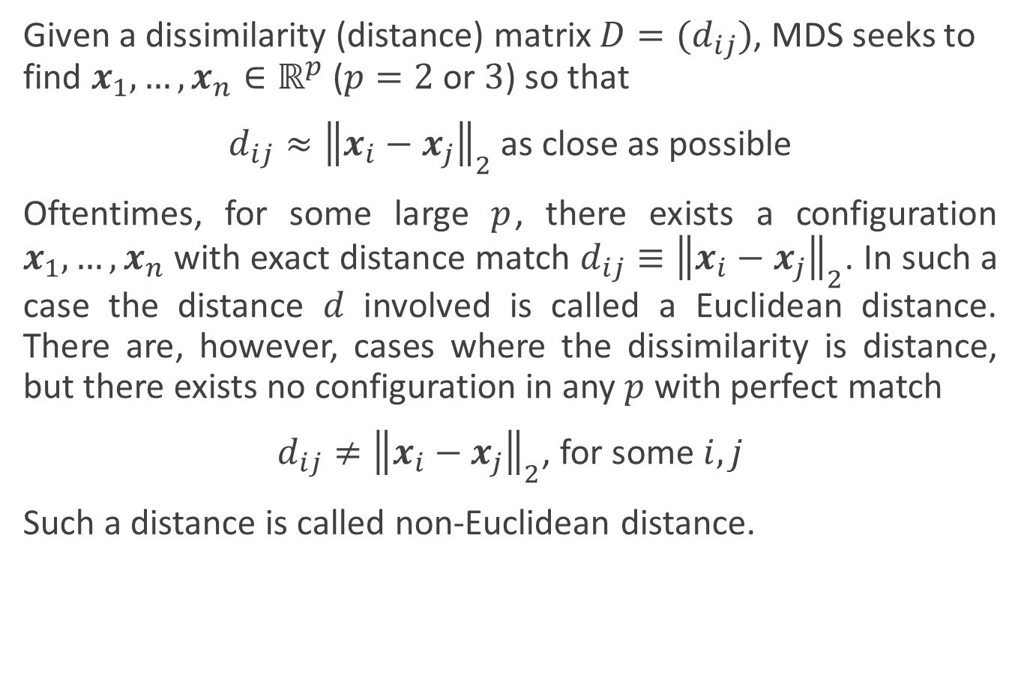
Euclidean and non-Euclidean distance
Given a dissimilarity (distance) matrix $D=(d_{ij})$, MDS seeks to find $x_{1}, …, x_{n}∈ℝ^{p}$ ($p=2$ or $3$) so that
$d_{ij}≈{\left\|x_{i}−x_{j}\right\|}_{2}$ as close as possible
Oftentimes, for some large $p$, there exists a configuration $x_{1}, …,x_{n}$ with exact distance match $d_{ij}≡{\left\|x_{i}−x_{j}\right\|}_{2}$. In such a case the distance $d$ involved is called a Euclidean distance. There are, however, cases where the dissimilarity is distance, but there exists no configuration in any $p$ with perfect match
$d_{ij}≠{\left\|x_{i}−x_{j}\right\|}_{2}$, for some $i,j$
Such a distance is called non-Euclidean distance.

Slide 29

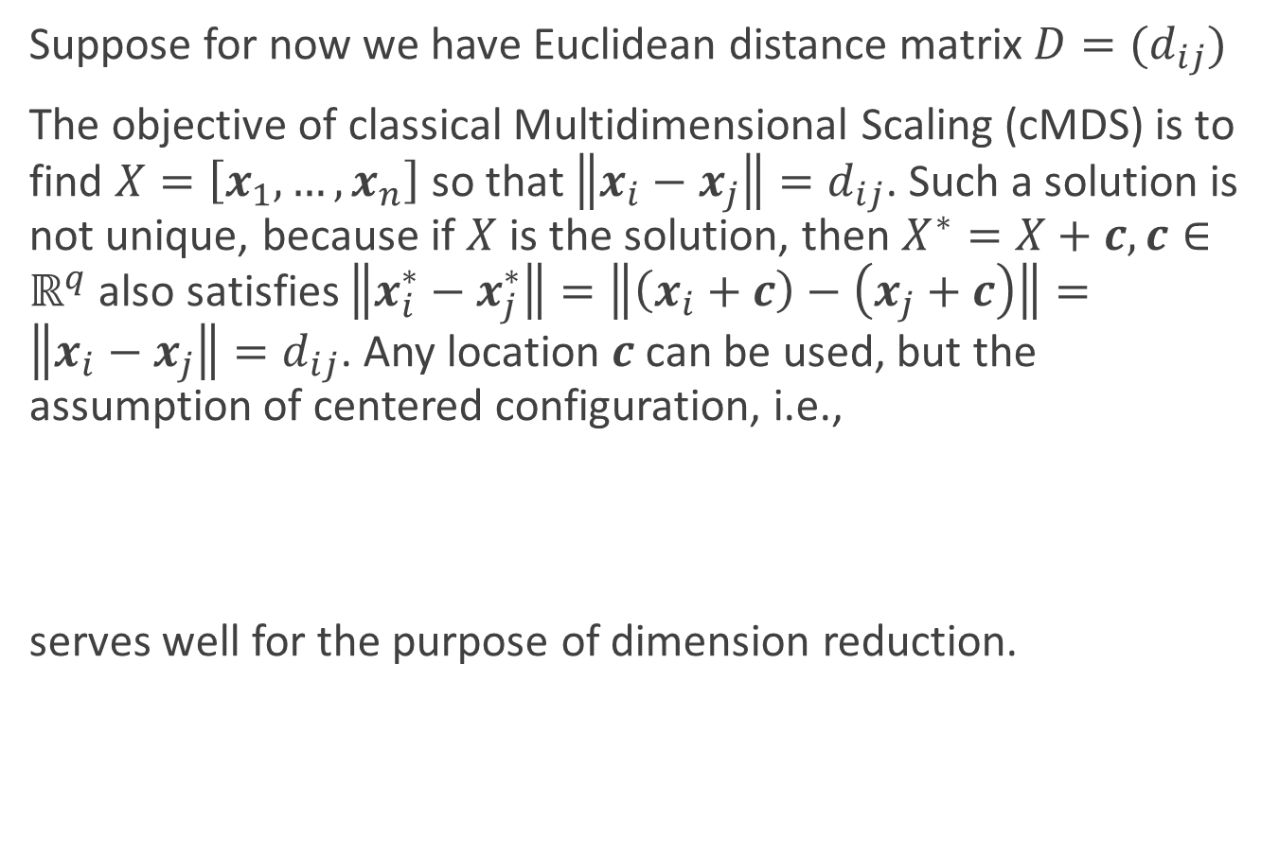
Classical Multidimensional Scaling
Suppose for now we have Euclidean distance matrix $D=(d_{ij})$
The objective of classical Multidimensional Scaling (cMDS) is to find $X=\left[x_{1}, …,x_{n}\right]$ so that $\left\|x_{i}−x_{j}\right\|=d_{ij}$. Such a solution is not unique, because if $X$ is the solution, then $X^{∗}=X+c,c∈ℝ^{q}$ also satisfies $\left\|x_{i}^{∗}−x_{j}^{∗}\right\|=\left\|\left(x_{i}+c\right)−\left(x_{j}+c\right)\right\|=\left\|x_{i}−x_{j}\right\|=d_{ij}$. Any location $c$ can be used, but the assumption of centered configuration, i.e.,
serves well for the purpose of dimension reduction.
$$\sum_{i=1}^{n}{x_{ik}}=0, \text{for} \text{all} k$$
(1)

Slide 30
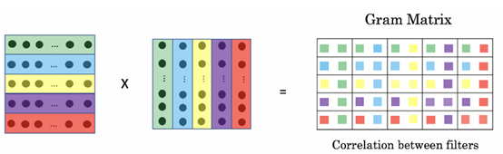
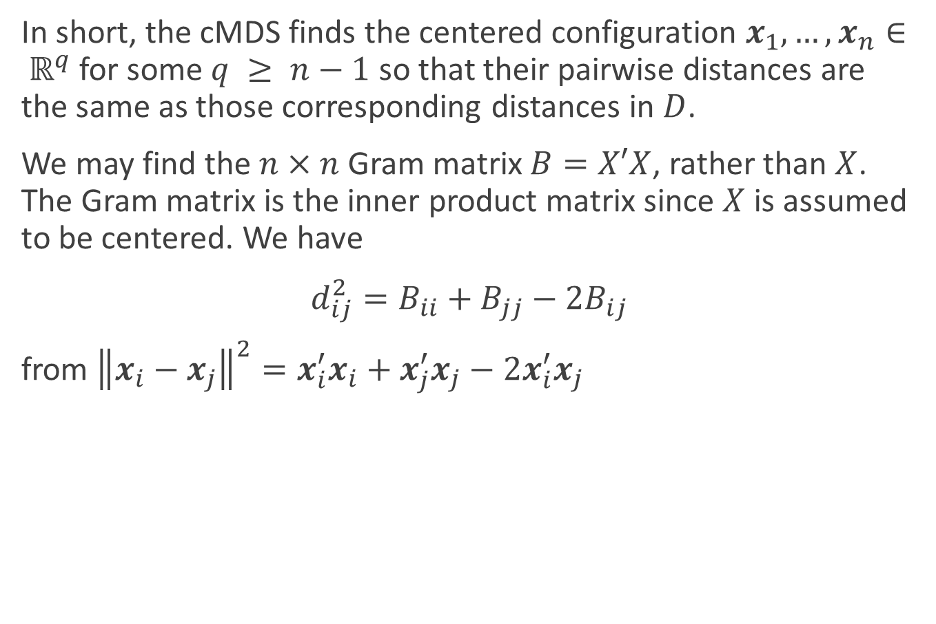

Classical Multidimensional Scaling
In short, the cMDS finds the centered configuration $x_{1}, …, x_{n}∈ ℝ^{q}$ for some $q ≥ n−1$ so that their pairwise distances are the same as those corresponding distances in $D$.
We may find the $n×n$ Gram matrix $B=X′X$, rather than $X$. The Gram matrix is the inner product matrix since $X$ is assumed to be centered. We have
$d_{ij}^{2}=B_{ii}+B_{jj}−2B_{ij}$
from ${\left\|x_{i}−x_{j}\right\|}^{2}=x_{i}^{′}x_{i}+x_{j}^{′}x_{j}−2x_{i}^{′}x_{j}$
(2)
$$B_{ij}=\left\langle x_{i},x_{j}\right\rangle$$
Notes:
格拉姆矩阵/Gram matrix

Slide 31
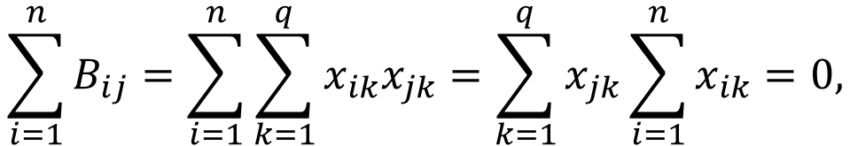

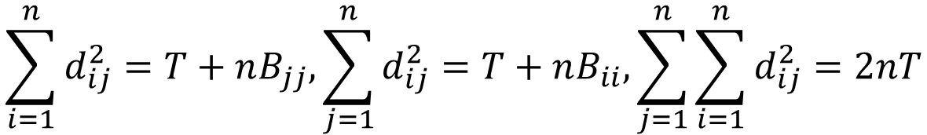
Classical Multidimensional Scaling
The constraints (1) leads to
for $j=1,…,n$
With a notation $T=trace\left(B\right)=\sum_{i=1}^{n}{B_{ii}}$, we have
$$\sum_{i=1}^{n}{B_{ij}}=\sum_{i=1}^{n}{\sum_{k=1}^{q}{x_{ik}x_{jk}}}=\sum_{k=1}^{q}{x_{jk}\sum_{i=1}^{n}{x_{ik}}}=0,$$
$$\sum_{i=1}^{n}{d_{ij}^{2}}=T+nB_{jj},\sum_{j=1}^{n}{d_{ij}^{2}}=T+nB_{ii},\sum_{j=1}^{n}{\sum_{i=1}^{n}{d_{ij}^{2}=2nT}}$$
(3)

Slide 32
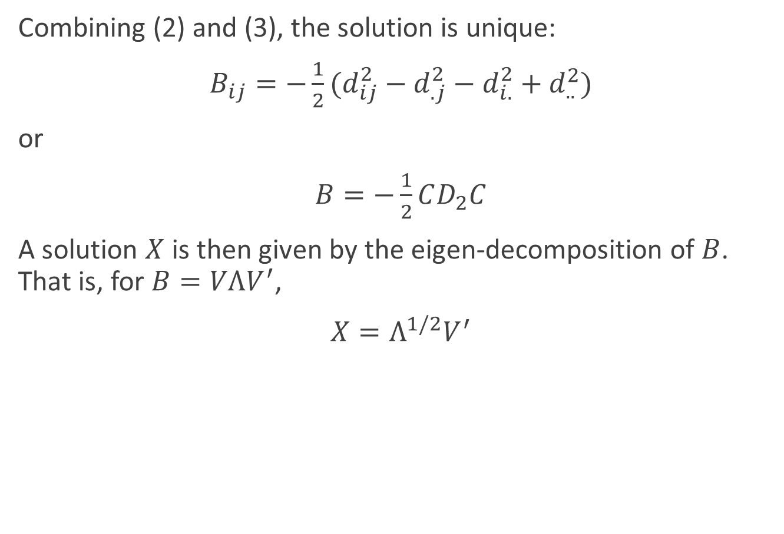
Classical Multidimensional Scaling
Combining (2) and (3), the solution is unique:
$B_{ij}=−\frac{1}{2}(d_{ij}^{2}−d_{.j}^{2}−d_{i.}^{2}+d_{..}^{2})$
or
$B=−\frac{1}{2}CD_{2}C$
A solution $X$ is then given by the eigen-decomposition of $B$. That is, for $B=VΛV^{′}$,
$X=Λ^{1/2}V^{′}$
(4)

Slide 33

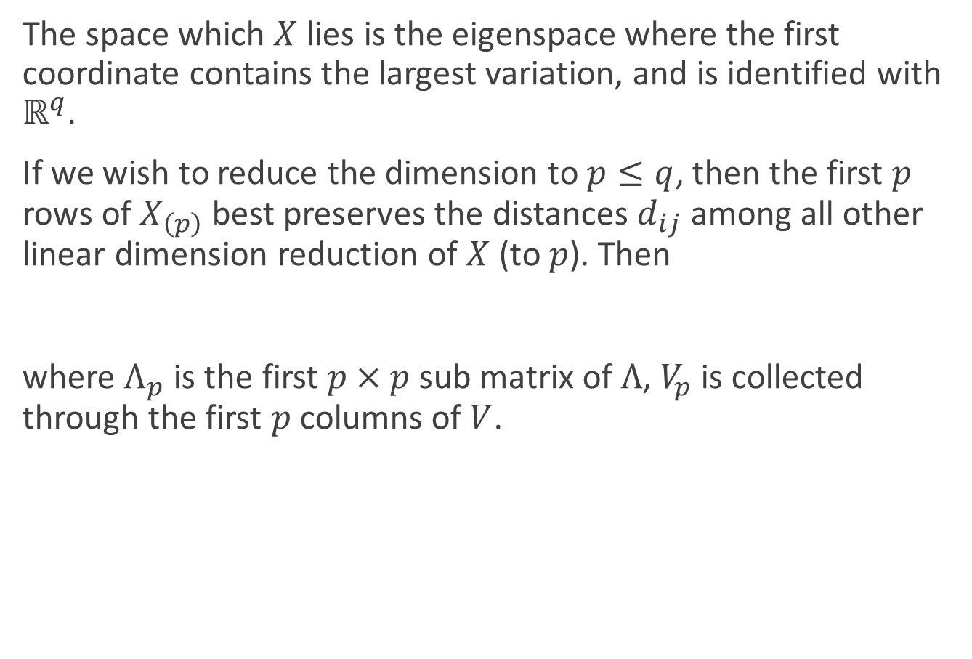
Classical Multidimensional Scaling
The space which $X$ lies is the eigenspace where the first coordinate contains the largest variation, and is identified with $ℝ^{q}$.
If we wish to reduce the dimension to $p≤q$, then the first $p$ rows of $X_{\left(p\right)}$ best preserves the distances $d_{ij}$ among all other linear dimension reduction of $X$ (to $p$). Then
where $Λ_{p}$ is the first $p×p$ sub matrix of $Λ$, $V_{p}$ is collected through the first $p$ columns of $V$.
$$X_{\left(p\right)}=Λ_{p}^{1/2}V_{p}^{′}$$

Slide 34
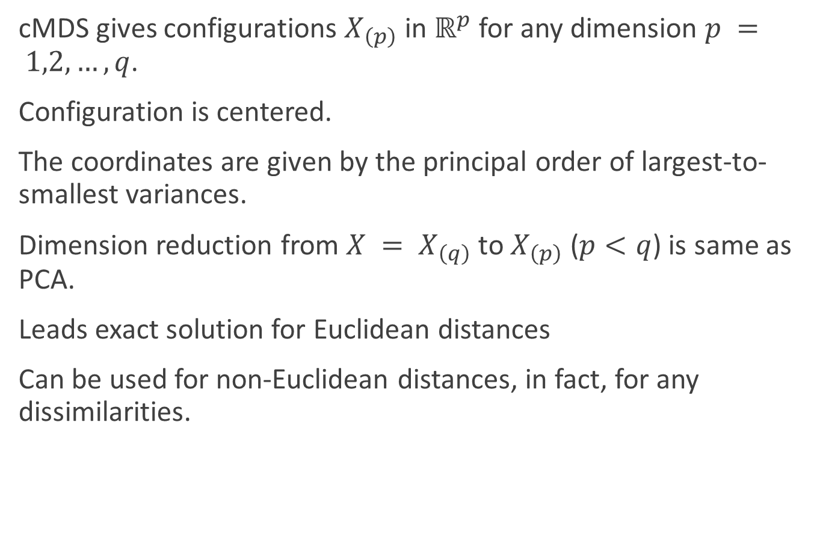
Classical Multidimensional Scaling
cMDS gives configurations $X_{\left(p\right)}$ in $ℝ^{p}$ for any dimension $p = 1,2,…,q$.
Configuration is centered.
The coordinates are given by the principal order of largest-to-smallest variances.
Dimension reduction from $X = X_{\left(q\right)}$ to $X_{\left(p\right)}$ ($p<q$) is same as PCA.
Leads exact solution for Euclidean distances
Can be used for non-Euclidean distances, in fact, for any dissimilarities.

Slide 35
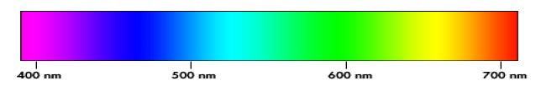
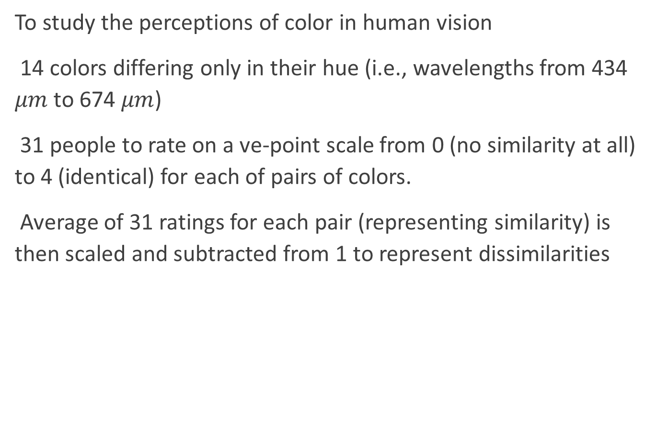
cMDS examples
To study the perceptions of color in human vision
14 colors differing only in their hue (i.e., wavelengths from 434 $μm$ to 674 $μm$)
31 people to rate on a ve-point scale from 0 (no similarity at all) to 4 (identical) for each of pairs of colors.
Average of 31 ratings for each pair (representing similarity) is then scaled and subtracted from 1 to represent dissimilarities

Slide 36
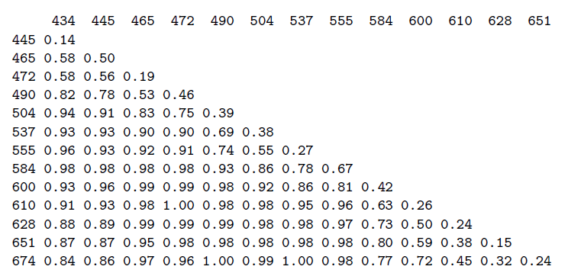

cMDS examples
The resulting $14×14$ dissimilarity matrix is symmetric, and contains zeros in the diagonal. MDS seeks a 2D configuration to represent these colors.

Slide 37
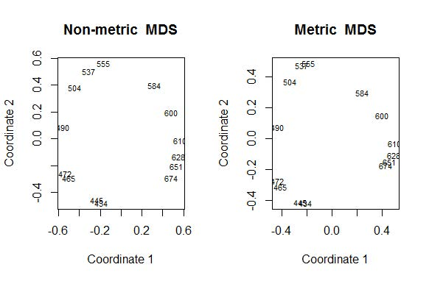
cMDS examples
MDS reproduces the well-known two-dimensional color circle.

Slide 38

cMDS examples
MDS reproduces the well-known two-dimensional color circle.

Slide 39
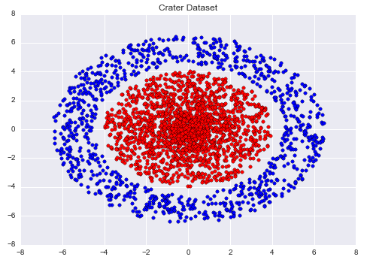
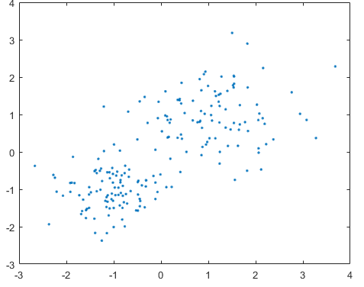
Metric learning
Each sample space defines a distance measure on attributes
Our goal is to find a sample space in which samples can be properly grouped under a proper distance measure
How?
We can learn a distance measure

Slide 40
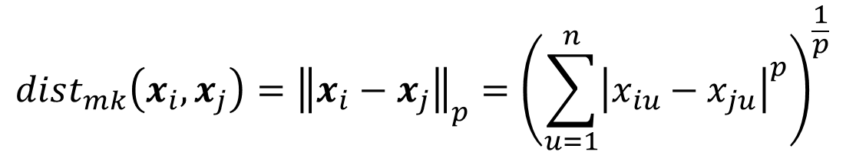

Distance measures
Some properties of a distance measure $dist(⋅,⋅)$:
Nonnegative: $dist\left(x_{i},x_{j}\right)≥0$
Identity: $dist\left(x_{i},x_{j}\right)=0 if and only ifx_{i}=x_{j}$
Symmetric: $dist\left(x_{i},x_{j}\right)=dist\left(x_{i},x_{i}\right)$
Triangle inequality: $dist\left(x_{i},x_{j}\right)≤dist\left(x_{i},x_{k}\right)+dist\left(x_{k},x_{j}\right)$
Minkowski distance
$$dist_{mk}\left(x_{i},x_{j}\right)={\left\|x_{i}−x_{j}\right\|}_{p}={\left(\sum_{u=1}^{n}{{\left|x_{iu}−x_{ju}\right|}^{p}}\right)}^{\frac{1}{p}}$$

Slide 41
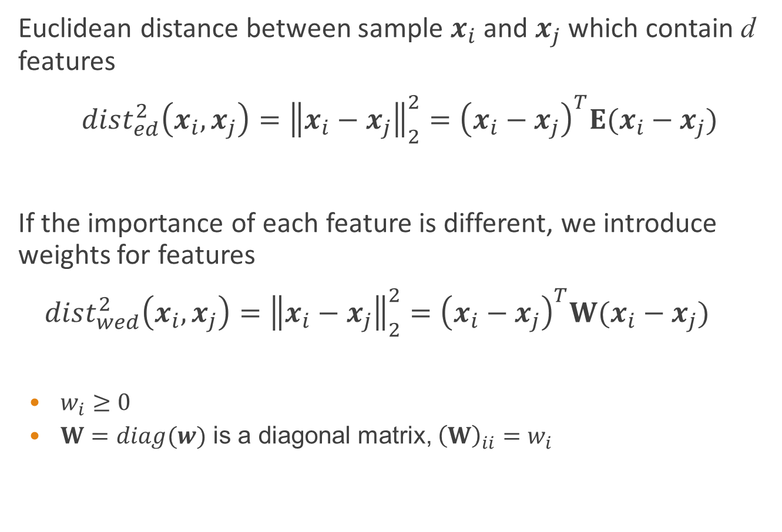
Extension of Euclidean distance
Euclidean distance between sample $x_{i}$ and $x_{j}$ which contain d features
$dist_{ed}^{2}\left(x_{i},x_{j}\right)={\left\|x_{i}−x_{j}\right\|}_{2}^{2}={\left(x_{i}−x_{j}\right)}^{T}E(x_{i}−x_{j})$
If the importance of each feature is different, we introduce weights for features
$dist_{wed}^{2}\left(x_{i},x_{j}\right)={\left\|x_{i}−x_{j}\right\|}_{2}^{2}={\left(x_{i}−x_{j}\right)}^{T}W(x_{i}−x_{j})$
$w_{i}≥0$
$W=diag(w)$ is a diagonal matrix, ${\left(W\right)}_{ii}=w_{i}$
$$=dist_{ij,1}^{2}+dist_{ij,2}^{2}+…+dist_{ij,d}^{2}$$
$$=w_{1}⋅dist_{ij,1}^{2}+w_{2}⋅dist_{ij,2}^{2}+…+w_{d}⋅dist_{ij,d}^{2}$$

Slide 42
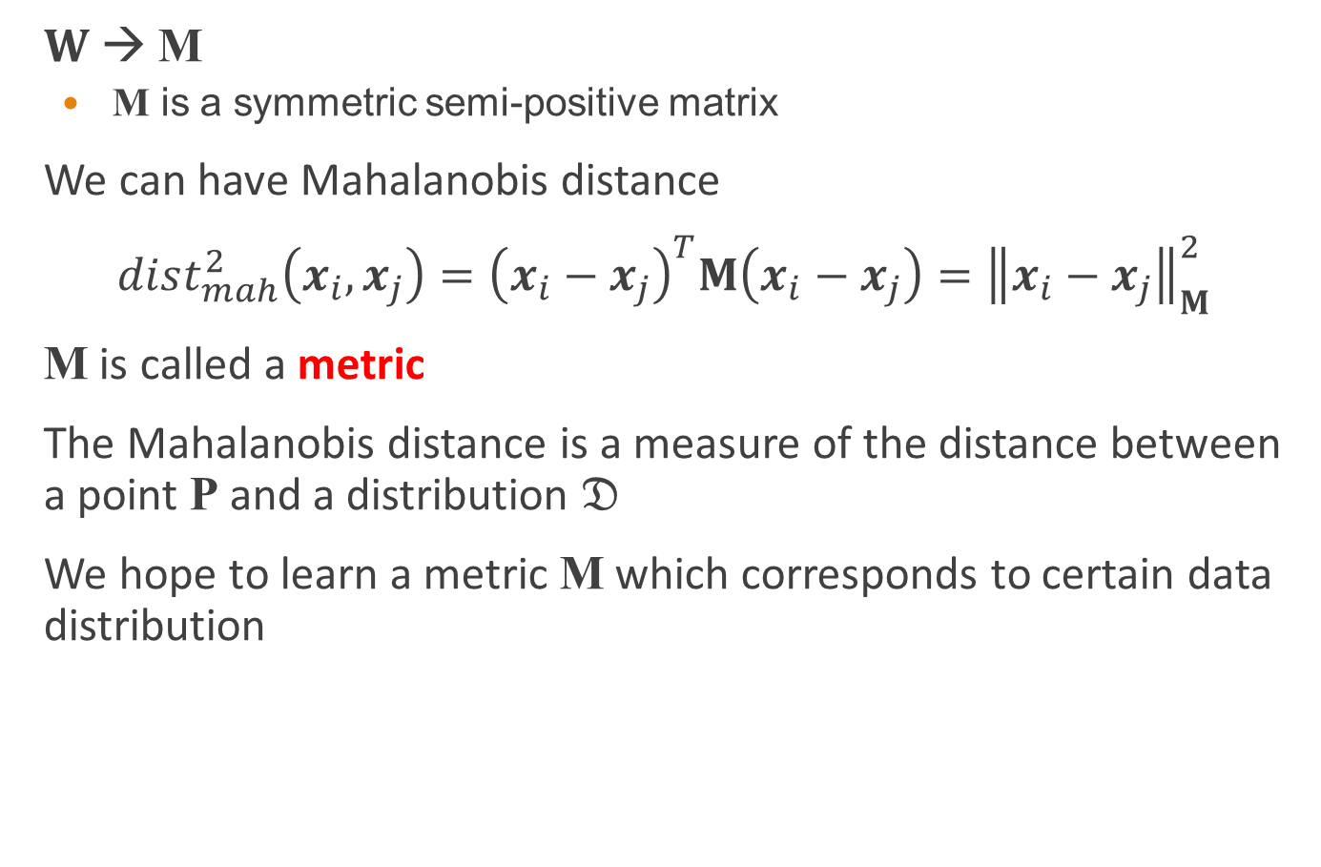
Mahalanobis distance
$W$ → M
M is a symmetric semi-positive matrix
We can have Mahalanobis distance
$dist_{mah}^{2}\left(x_{i},x_{j}\right)={\left(x_{i}−x_{j}\right)}^{T}M\left(x_{i}−x_{j}\right)={\left\|x_{i}−x_{j}\right\|}_{M}^{2}$
M is called a metric
The Mahalanobis distance is a measure of the distance between a point P and a distribution $𝔇$
We hope to learn a metric M which corresponds to certain data distribution

Slide 43
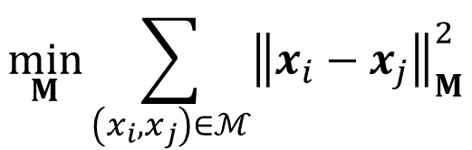


Learn a metric using priori knowledge
If some priori knowledge has been given
Must-link set $ℳ$: if $\left(x_{i},x_{j}\right)∈ℳ$, it means $x_{i}$and $x_{j}$ are similar
Cannot-link set $C$: if $\left(x_{i},x_{j}\right)∈C$, it means $x_{i}$and $x_{j}$ are dissimilar
We can find a metric M by solving the following optimization problem
$$\min_{M}{\sum_{\left(x_{i},x_{j}\right)∈ℳ}{{\left\|x_{i}−x_{j}\right\|}_{M}^{2}}}$$
$$s.t. \sum_{\left(x_{i},x_{j}\right)∈C}{{\left\|x_{i}−x_{j}\right\|}_{M}^{2}≥1}$$
$M≽0$

Slide 44

Dimension reduction using a learned metric
If the learned metric $M$ is a low-rank matrix, we can find a set of orthogonal basis of $M$ by performing eigenvalue decomposition
A matrix $P∈ℝ^{d×rank(M)}$ can be used to reduce dimensions of sample space

